Slide 1
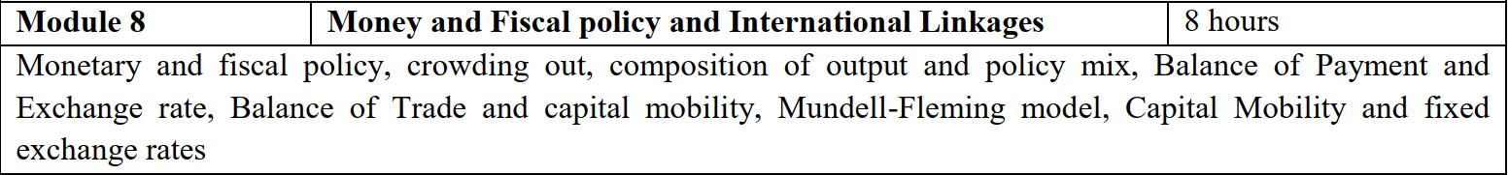

Slide 2
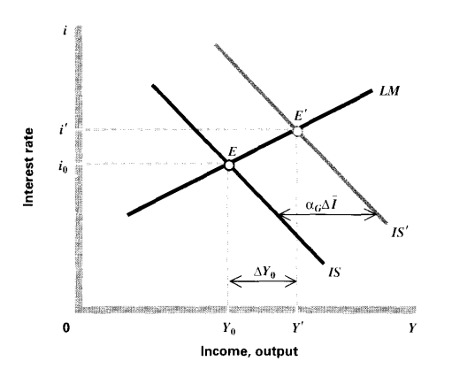

Changes in i & Y
When IS or LM curves shift
$∆\overline{I}$
Shift the IS curve by $α_{G}∆\overline{I}$
Change in income $∆Y_{0}$, which is less
Why we couldn’t achieve the fuller multiplier effect?

Slide 3
Introduction
Use of IS-LM curve to show how MP and FP work
Interchangeably use to get a reasonable rate of growth with low inflation
why inflation is good?
FP has its initial impact in the goods market and MP in the assets market

Slide 4
Monetary Policy
Effects of an increase in the quantity of money
Instruments:
Quantitative
1. Bank rate policy
2. Open market operation (T bill, Dated G-Secs,)
3. Variation in the reserve ratios
Qualitative
1. Fixing margin requirements
2. Credit rationing
3. Moral Suasion
4. Direct action

Slide 5
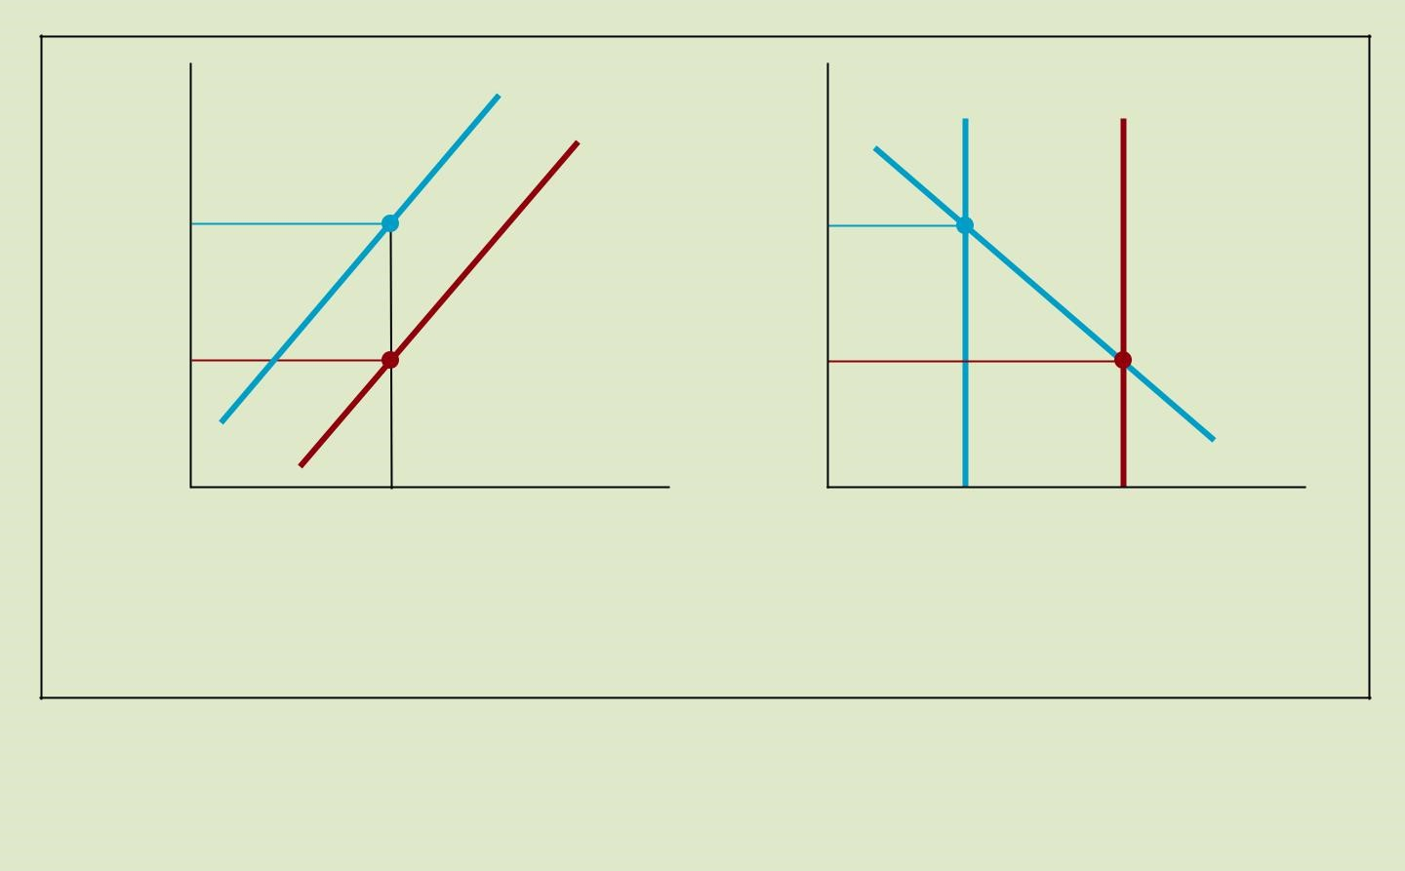
Changes in Money supply and shift in LM curve
LM₁
Interest rate i
M ^{s}
1
M ^{s}
2
Interest rate i
LM₂
iA
A
A
iB
B
B
Md( Y A)
Y_{A}
Output
SS/DD

Slide 6
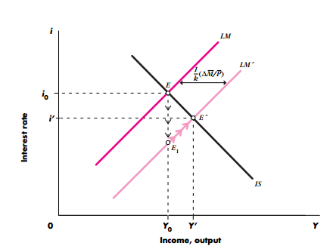
The transmission mechanism

Slide 7
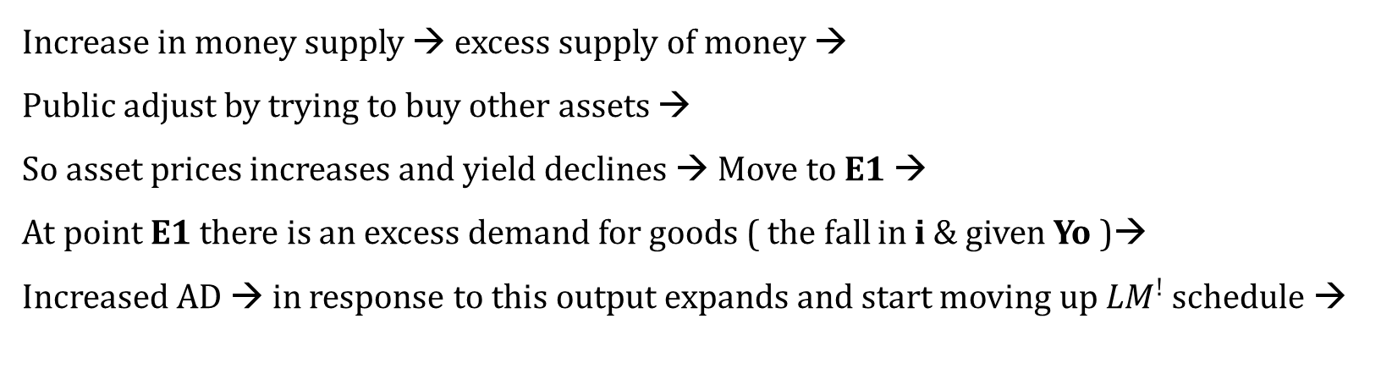
Continues…
Two steps;
1. Change in Money supply changes interest rate
2. change in interest rate affect aggregate demand
Through these two linkages, changes in real money stock affect the level of output in the economy.
Increase in money supply → excess supply of money →
Public adjust by trying to buy other assets →
So asset prices increases and yield declines → Move to E1 →
At point E1 there is an excess demand for goods ( the fall in i & given Yo )→
Increased AD → in response to this output expands and start moving up ${LM}^{!}$ schedule →

Slide 8
Thus increase in Money stock first causes interest rate to fall as the public adjusts their portfolio and then- through lower interest rate- increases aggregate demand.

Slide 9
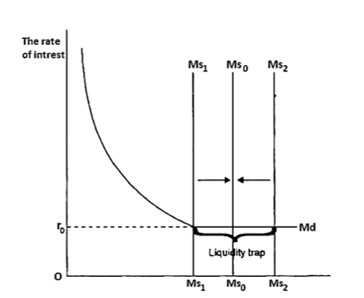
Liquidity trap: Extreme case I
The liquidity trap is the situation in which prevailing interest rates are low and
saving rates are high, making monetary policy ineffective.

Slide 10
The liquidity trap
The liquidity trap is the situation in which prevailing interest rates are low and saving rates are high, making monetary policy ineffective.
Expansionary monetary policy does not changes the interest rate, income and hence does not stimulate economic growth
Makes LM curve horizontal
When interest rate is zero, public would not want to hold any bonds

Slide 11
LM1
Y
Y1

Slide 12
Extreme case II
Case of vertical LM curve
Demand for money is entirely unresponsive to the interest rate
When LM curve is vertical, a given change in quantity of money has a maximum effect on income.
What do you think about an expansionary FP policy, when LM curve is vertical?

Slide 13

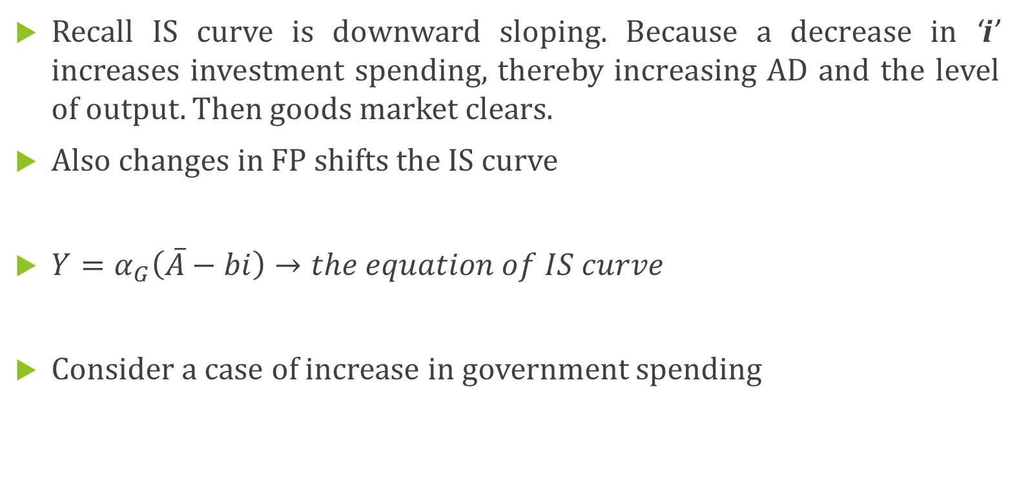
Fiscal Policy and Crowding out
Recall IS curve is downward sloping. Because a decrease in ‘i’ increases investment spending, thereby increasing AD and the level of output. Then goods market clears.
Also changes in FP shifts the IS curve
$Y=α_{G}\left(\overline{A}−bi\right)→the equation of IS curve$
Consider a case of increase in government spending

Slide 14
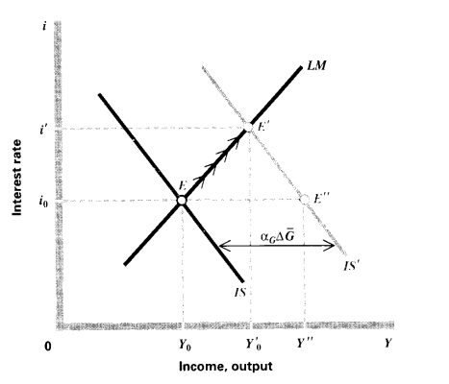
The increase in government spending crowd out private investment spending.

Slide 15
Expansionary FP under the two extreme cases?

Slide 16
The composition of output and policy mix
Policy | Equilibrium income | Equilibrium interest rate
Monetary expansion | + | -
Fiscal expansion | + | +
The choice between these two policies as tools of stabilization
The flexibility and speed with which these policies can be implemented and take effect.
What these policies do to the components of AD
Monetary policy → Investment
Fiscal Policy → Operate in a manner that depends on precisely on changes in G, TA, TR

Slide 17
Each policy affects the level of AD and output thereafter
For Eg:
Increase in govt spending raises cpn spending along with govt purchases
An income tax cut→ direct effect on cpn
An Investment subsidy → increases investment spending
Govt can increase investment spending . For eg: Investment tax credit

Slide 18
An investment subsidy
E1
i1
Interest rate
Interest rate
E
io
Io
IS1
I
IS
Income/output
Investment

Slide 19
Alternative Fiscal Policies
 | Interest rate | Consumption | Investment | GDP
Income tax cut | + | + | - | +
Govt. Spending | + | + | - | +
Investment Subsidy | + | + | + | +

